Slide 1
ERP
Models a whole company in software
Is in code
Can not be created by the people that do the daily work -> Hence need to communicate

Slide 2
Authority
Business Process Model and Notation (BPMN)
Version 2.0.2
2013
Standard developed by Object Management Group (OMG)

Slide 3
Notation

Slide 4
Agenda
20 seconds per slide exaplining all the parts of the handout briefly
show an example for each
Explain the example how everything is walked through

Slide 5
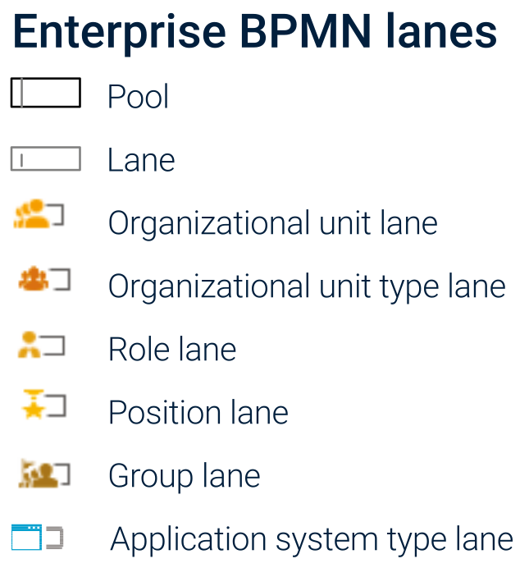

Slide 6
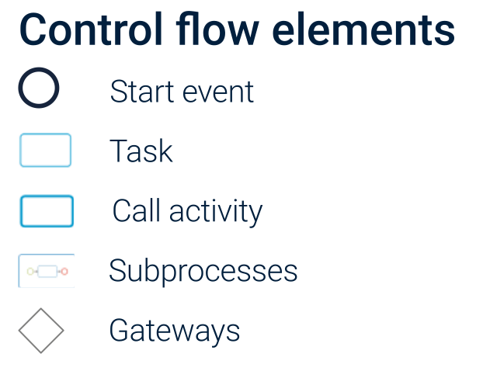

Slide 7
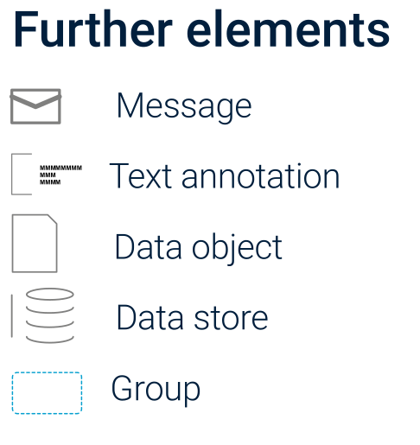

Slide 8
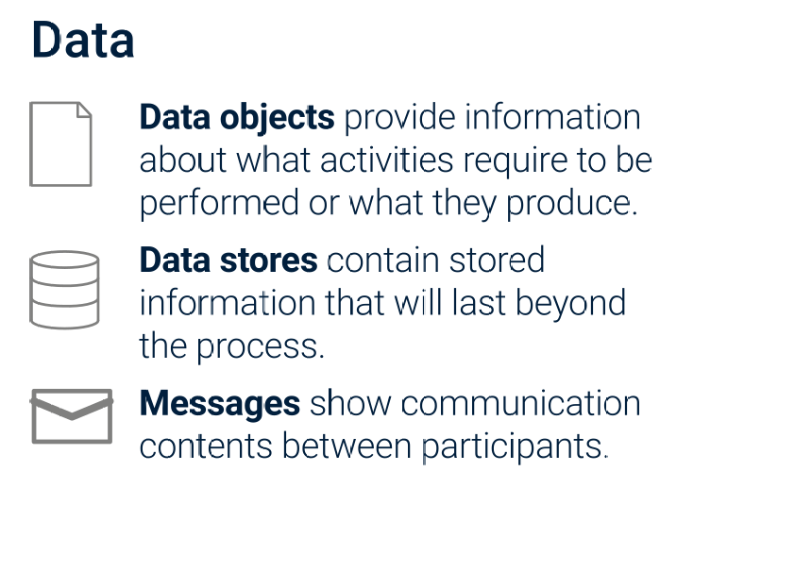

Slide 9
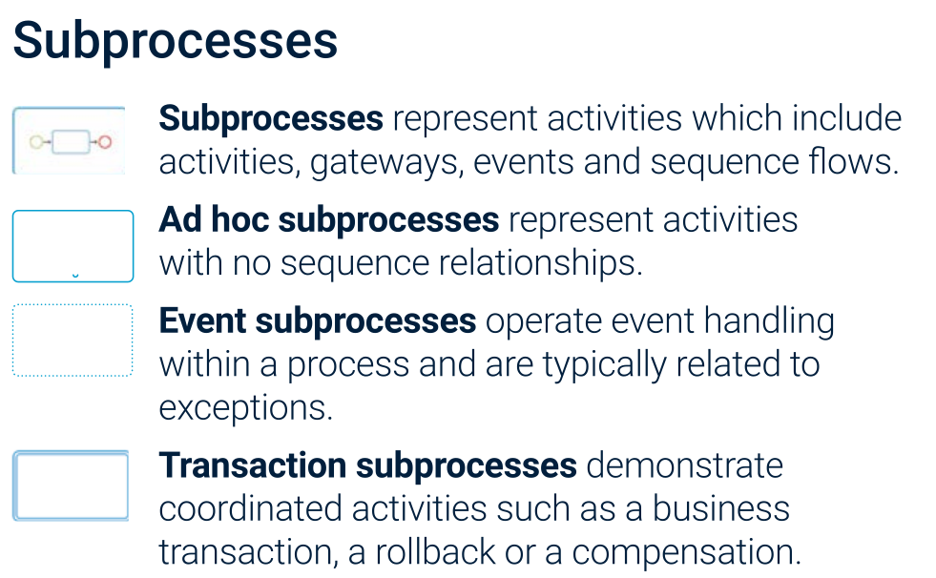

Slide 10
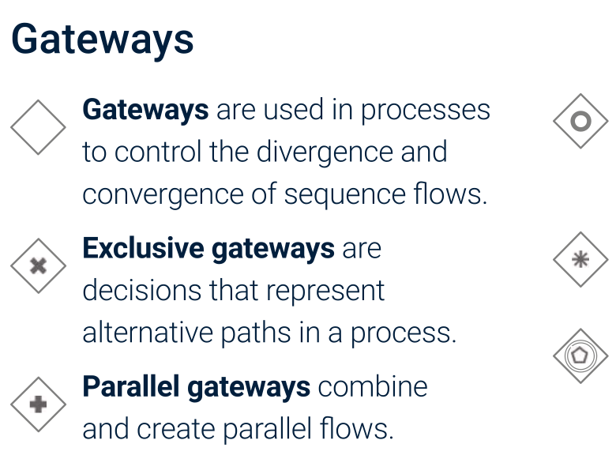

Slide 11
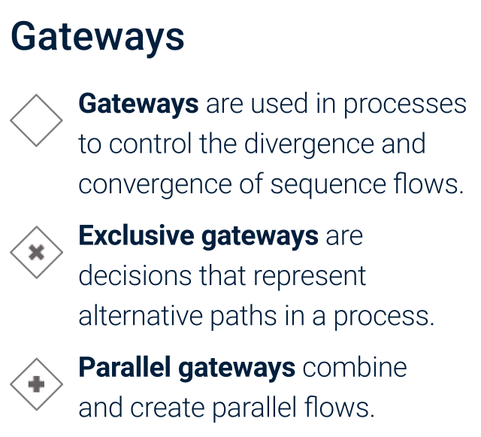

Slide 12
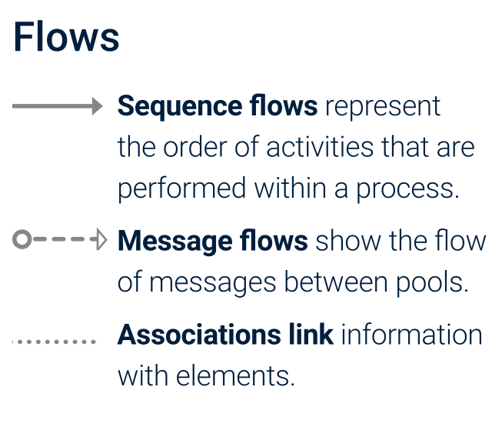

Slide 13
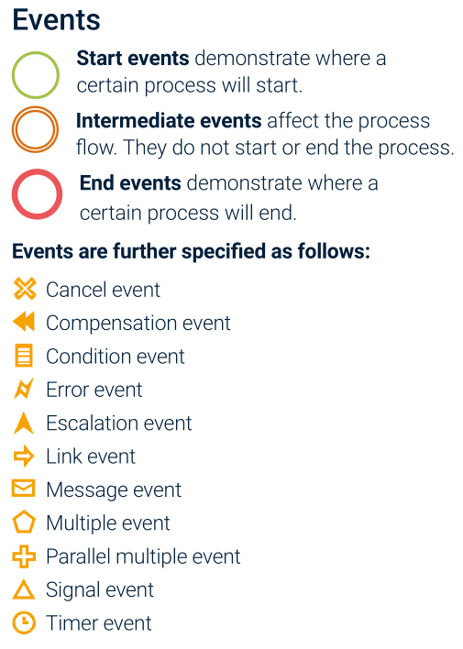

Slide 14
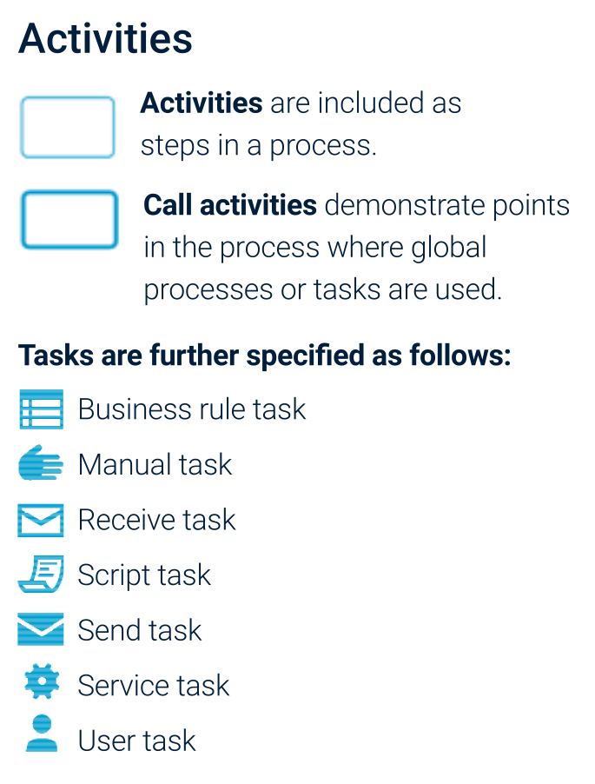

Slide 15
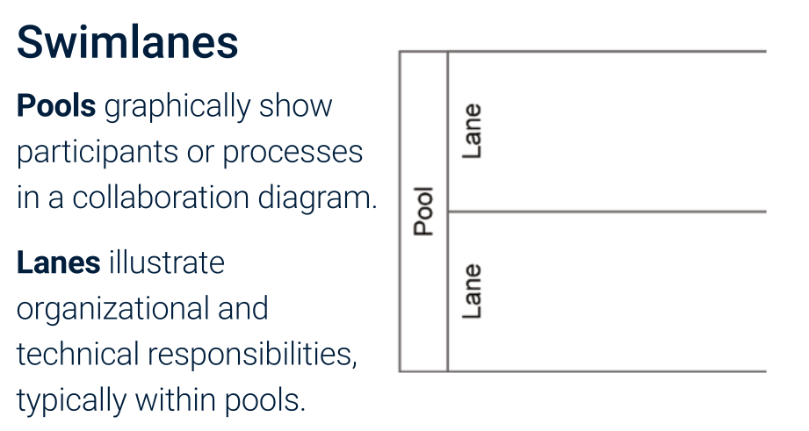

Slide 16
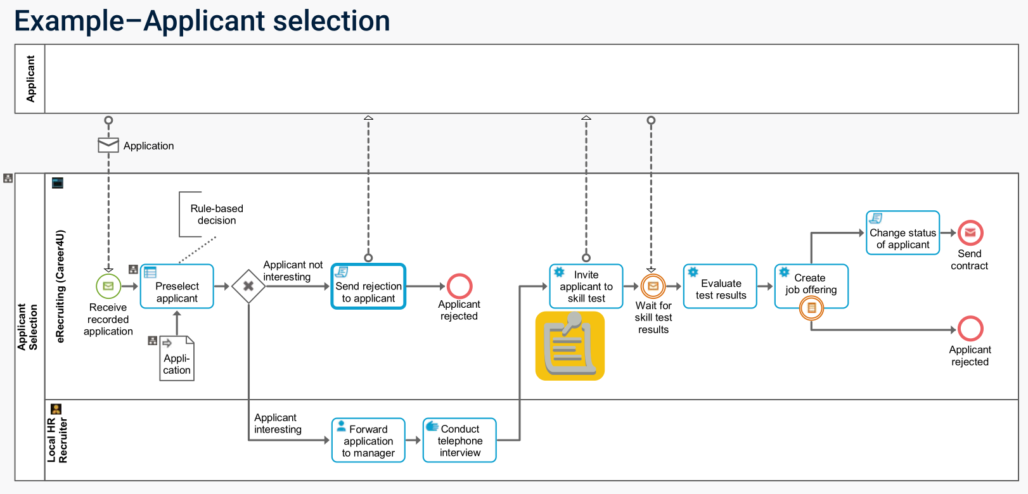
Example of a process
https://ariscommunity.com/know-how/cheat-sheets/bpmn-20-aris
Notes:
FInally how will everything look in a real life example?
This process illustrates applicant selecion
(maybe better have an IT process

Slide 17
Choreographies
Having understood a single process, we can model a whole company -> choreographs multiple processes for value creation
To make more money need to improve processes -> BPMN used by consultants to translate between the technical and the day-to-day

Slide 18
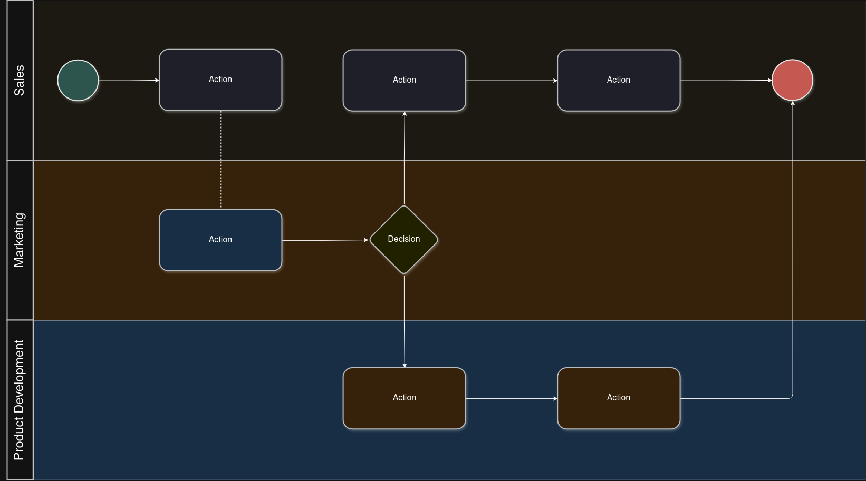
Draw.io
Free
Easy
Self-Hosted (400MB)

Slide 19
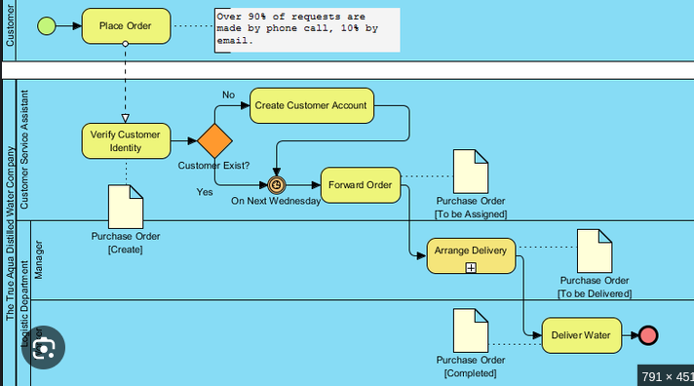
Visual Paradigm
Corporate Ready
Collaboration

Slide 20
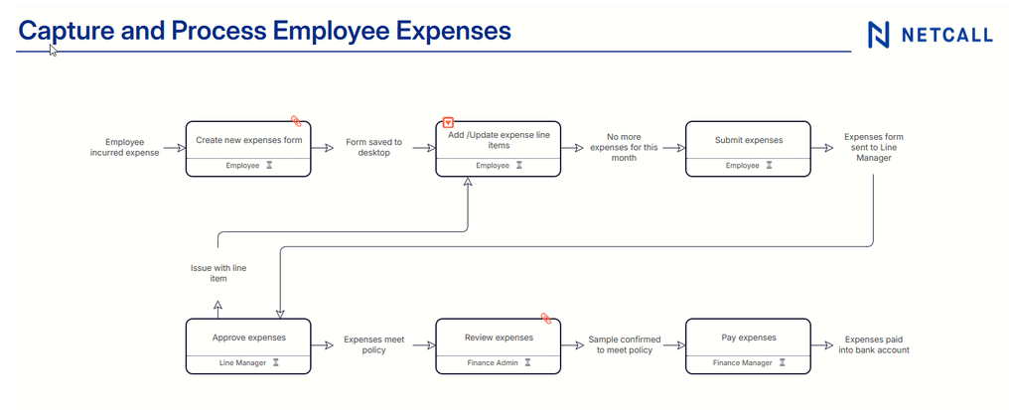
Netcall - UPN
Drill Down
Collaboration
Source: https://www.netcall.com/blog/what-is-upn/​

Slide 21
Camuda
Modern
Self-Hosted
Agentic Orchestration
https://camunda.com/orchestrate/processes/

Slide 22
Sources
https://www.visual-paradigm.com/features/
https://www.netcall.com/blog/what-is-upn/
draw.io
https://drawio-app.com/bpmn/
https://hub.docker.com/r/jgraph/drawio

Slide 23
Practical Part 1 (30 minutes)
Guided Modeling Exercise
Run our docker image (pulls draw.io and example diagram)
Read the case (like Team4S)
Model this in draw.io (check provided template)

Slide 24
Practical Part 2
Own work
Run our docker image (pulls draw.io and example diagram)
Find the problem in this process in terms of focus XY and improve it. Then send solution SVG via mail to us.

